Slide 1
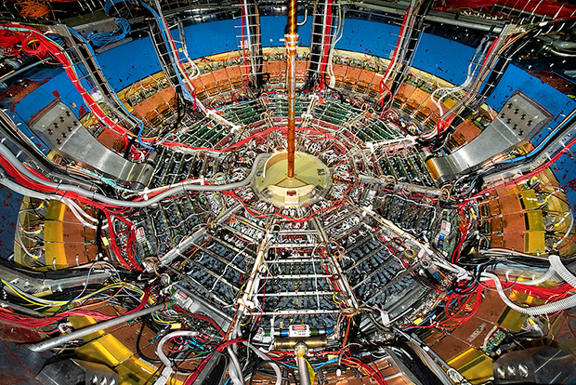
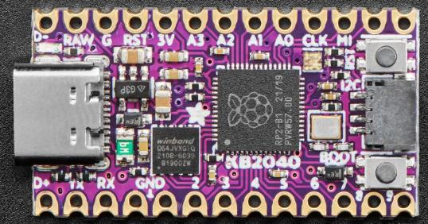
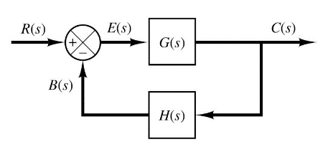

Control Systems
Engineering
(CSE 201)
Student #1
Student #2
Student #3
Team 05
Resistor-Capacitor Circuits
ADC and DAC Converters

Slide 2
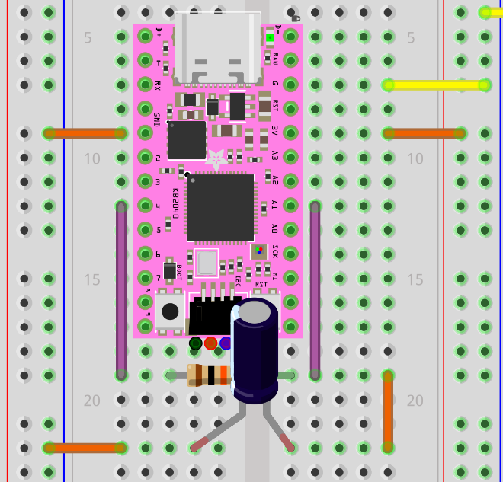
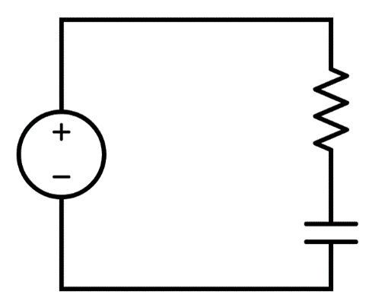
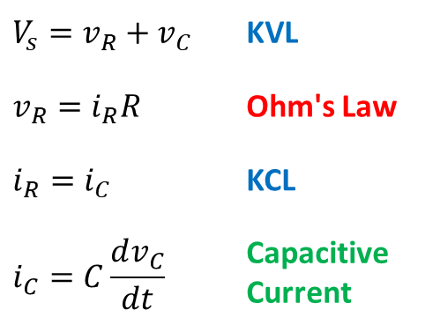


Our Challenge: Build an RC Circuit
Pin D4 → DAC mode, Pin A1 → ADC mode
We measured via an ADC the
voltage drop across the resistor
+3.3V
10KΩ
D4
A1
A1
GND
10$μ$F

Slide 3






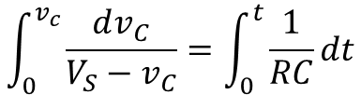



Series Resistor-Capacitor (RC) Circuit
$$V_{S}=RC\frac{dv_{C}}{dt}+v_{C}$$
R
$$\frac{dv_{C}}{dt}=\frac{V_{S}−v_{C}}{RC}$$
V_{S}
C
$$\frac{dv_{C}}{V_{S}−v_{C}}=\frac{1}{RC}dt$$
$$V_{s}=v_{R}+v_{C}$$
KVL
$$\int_{0}^{v_{c}}{\frac{dv_{C}}{V_{S}−v_{C}}}=\int_{0}^{t}{\frac{1}{RC}dt}$$
$$v_{R}=i_{R}R$$
Ohm's Law
$$i_{R}=i_{C}$$
KCL
$$\ln\left(V_{S}−v_{C}\right)−\ln\left(V_{S}\right)=\frac{−t}{RC}$$
$$i_{C}=C\frac{dv_{C}}{dt}$$
Capacitive Current

Slide 4
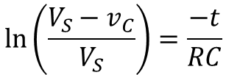

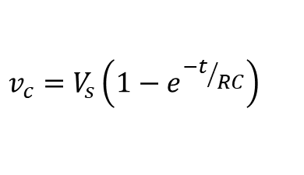

Series Resistor-Capacitor (RC) Circuit
$$\ln\left(V_{S}−v_{C}\right)−\ln\left(V_{S}\right)=\frac{−t}{RC}$$
R
V_{S}
$$\ln\left(\frac{V_{S}−v_{C}}{V_{S}}\right)=\frac{−t}{RC}$$
C
KVL
$$\frac{V_{S}−v_{C}}{V_{S}}=e^{{−t}/{RC}}$$
$$V_{s}=v_{R}+v_{C}$$
$$v_{R}=i_{R}R$$
Ohm's Law
$$i_{R}=i_{C}$$
KCL
$$v_{c}=V_{s}\left(1−e^{{−t}/{RC}}\right)$$
$$i_{C}=C\frac{dv_{C}}{dt}$$
Capacitive Current
The voltage across the charging capacitor as a function of time

Slide 5
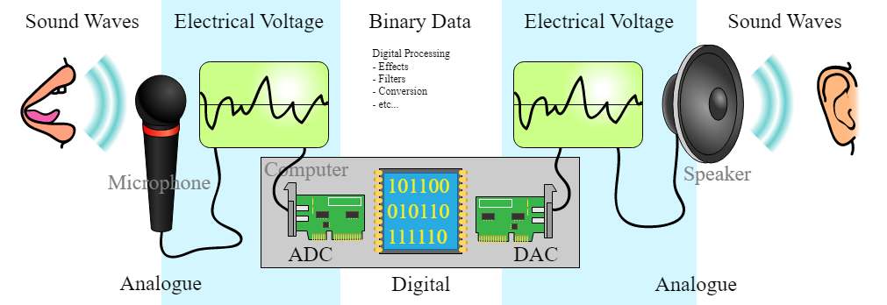
RP2040 ADC (input) vs. DAC (output)
ADC = Analog to Digital Converter
Reads a voltage between +3.3V to GND and returns an integer between 0-65,535:
65,535 = +3.3V, 0 = GND
DAC = Digital to Analog Converter
Given an integer between 0 and 65,535 the MCU outputs a fixed voltage:
65,535 = +3.3V, 0 = GND
RP2040 can sense only 4,096 distinct voltage levels
RP2040 can output only 4,096 distinct voltage levels

Slide 6
Our Approach
code.py running on KB2040
rc_decay.py running on Laptop
Waits for a serial (USB) port connection from the laptop
Connects to the KB2040 over the serial (USB) port
NeoPixel is GREEN
Waits for the command "r" to be sent by the laptop over the USB (CDC Data) port
Sends the string "r" to the KB2040 over the CDC Data port
Waits to receive the volts and times from the KB2040
Sets NeoPixel to BLUE to fully discharge capacitor, then to RED as it recharges the circuit while measuring volts & times
Plots the voltage vs. time graph for the RC circuit and saves a PNG file of the plot window
Sets NeoPixel to YELLOW as it sends the volts and times to the laptop over the USB port

Slide 7
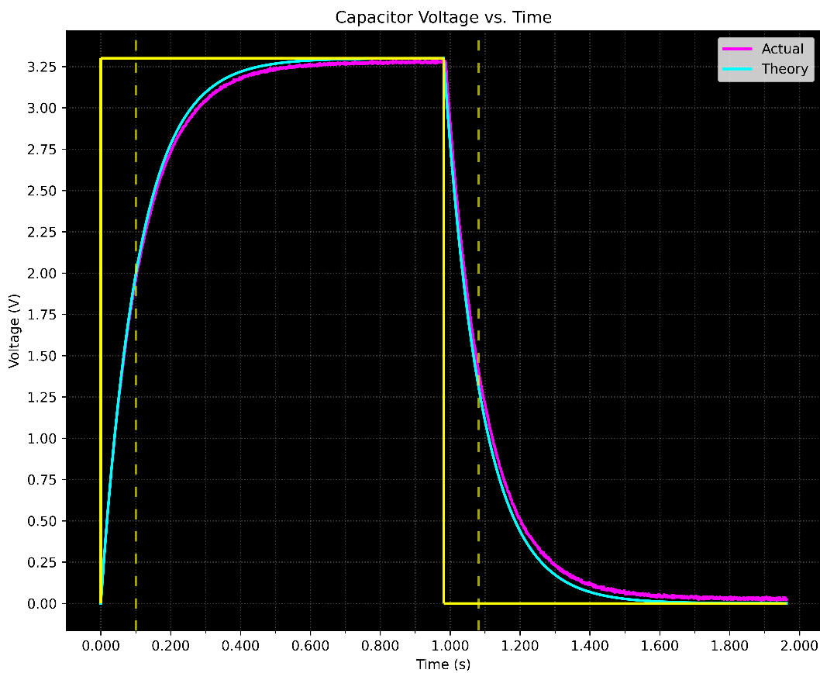
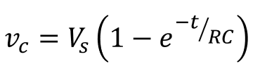
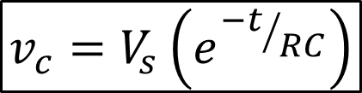
Our Result
$$v_{c}=V_{s}\left(e^{{−t}/{RC}}\right)$$

Slide 8
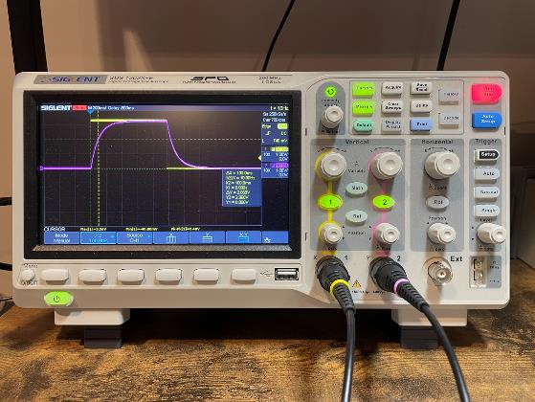
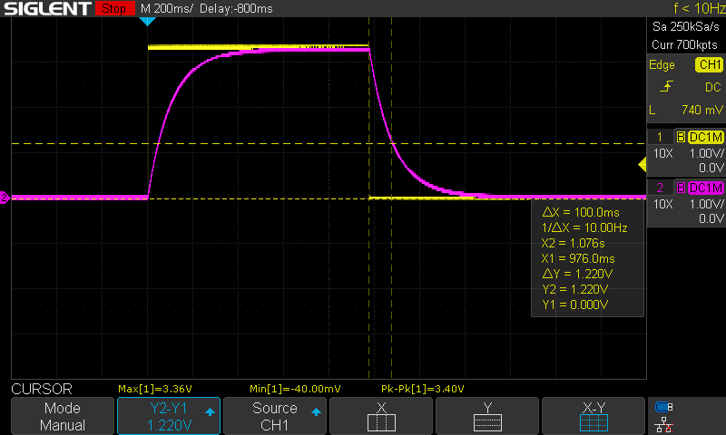
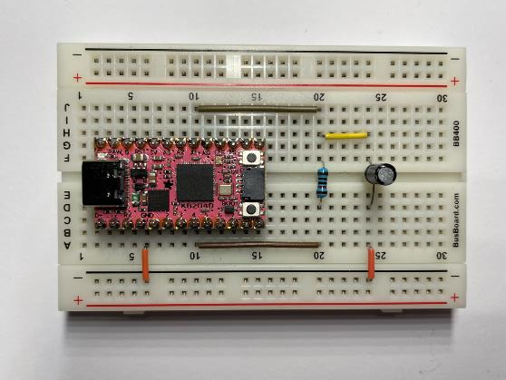
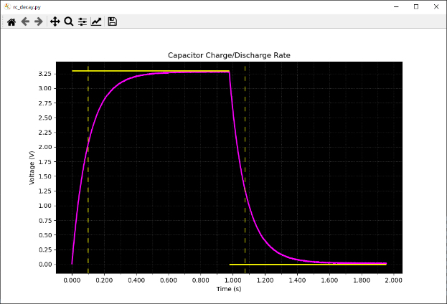


$$\$450 Oscilloscope$$
$$\$10 Computer$$

Slide 9
Team 05 – What We Learned
How to calculate the “voltage over time” of a resistor-capacitor circuit as it charges and then discharges
How to apply Kirchhoff's Voltage Law (KVL) and Kirchhoff's Current Law (KCL) to evaluate a circuit
How to model a circuit’s voltage and current using differential equations
The purpose and function of an analog-to-digital (ADC) converter and a digital-to-analog (DAC) converter
How a $10 microcontroller can perform many of the same functions as a $450 oscilloscope

